Slide 1
HW 6 CSE 546
Quyen Tran

Slide 2
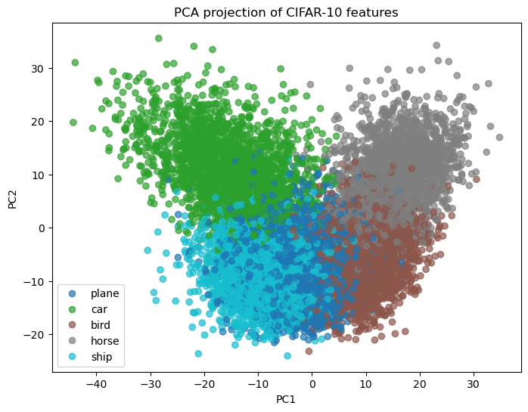
2D PCA
More overlapping classes, less distinction between each class.
PCA finds the plane class similar to the car class and the ship class.

Slide 3
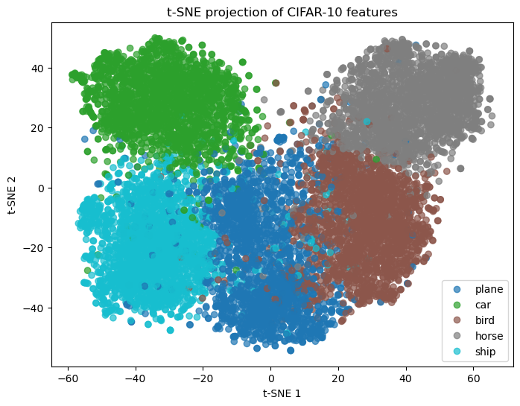
2D T-SNE
More distinction between each class, farther space from each other

Slide 4
PCA versus T-SNE
T-SNE is better at showing the difference between the classes .

Slide 5
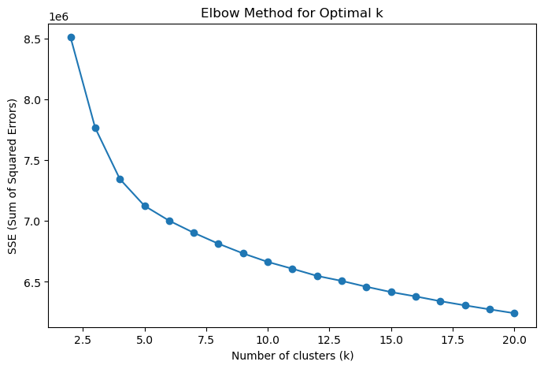
Original Data Clustering
K= 5 as optimal parameter because when k> 5, the graph starts to flatten out and too big of a k can lead to too complex of a model for not much gain, which is a bad trade off.

Slide 6
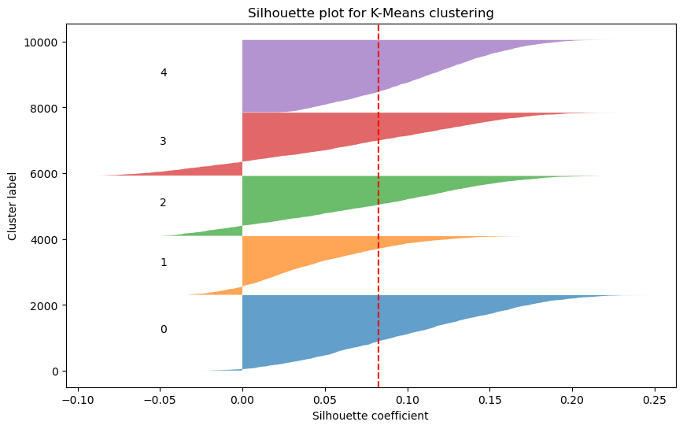
Original Data Silhouette plot
Here, you can see that a lot of values are close to 0 and there are some negative values, meaning samples lie on the border or they may be assigned to the wrong class (if negative).

Slide 7
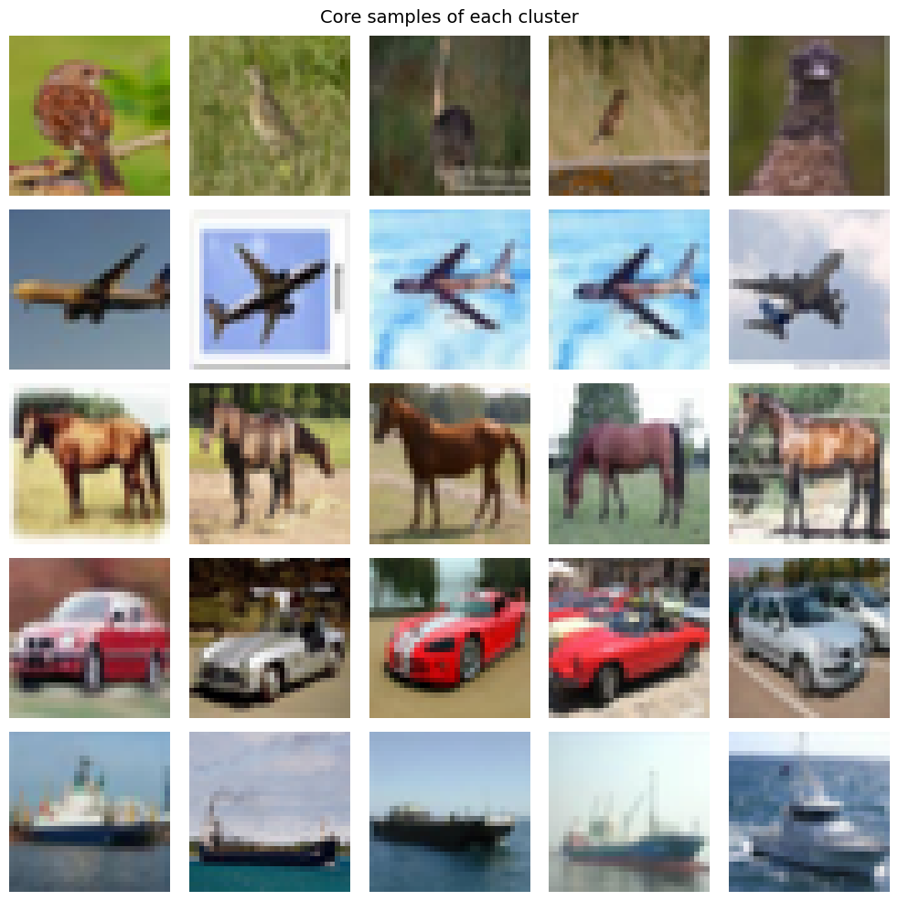
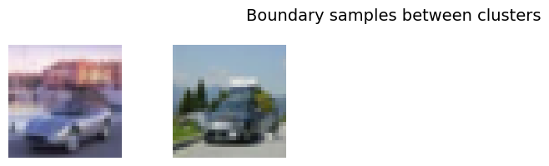
Core and Boundary Points
Core samples

Slide 8
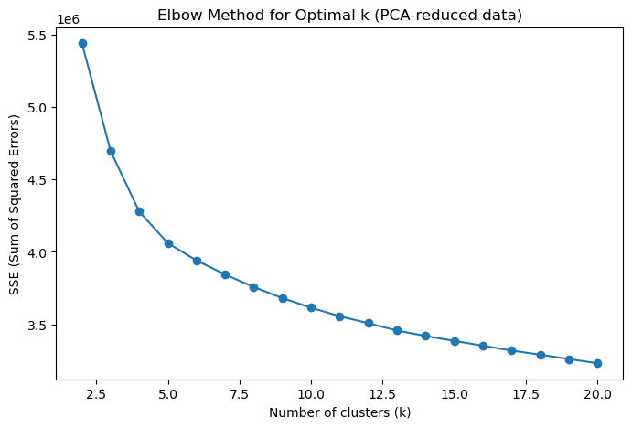
20D PCA Clustering
K= 5 as optimal parameter because when k> 5, the graph starts to flatten out and too big of a k can lead to too complex of a model for not much gain, which is a bad trade off.
Note smaller SSE when PCA is applied

Slide 9
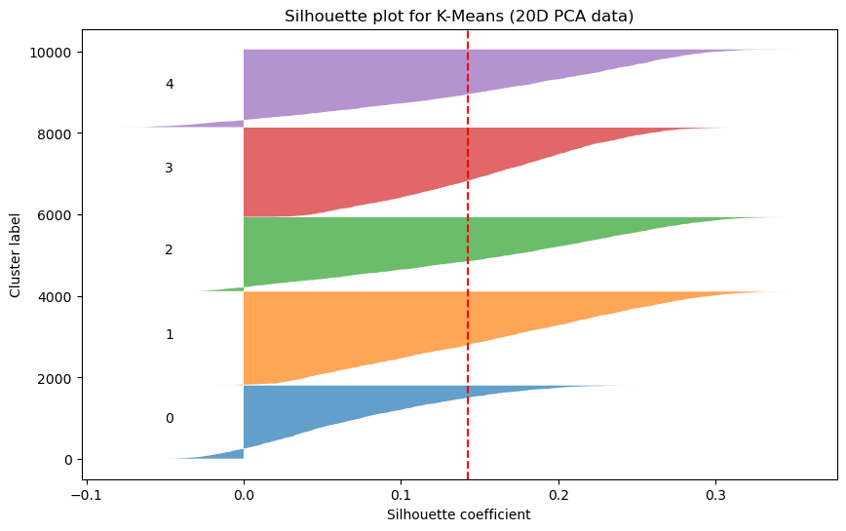
20D PCA Silhouette Plot
With PCA, there are less negative samples and the height is shorter near zero, meaning there are less samples close to zero.

Slide 10
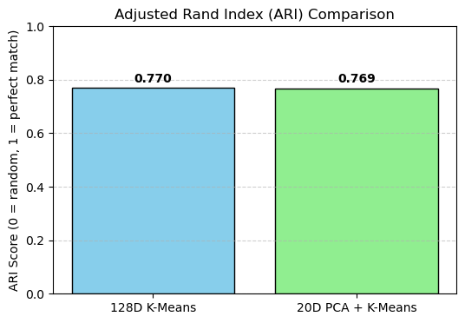
Rand Index Comparison
Very Similar ARI
Both relatively high ARI score so clustering is not random and align with true lables

Slide 11
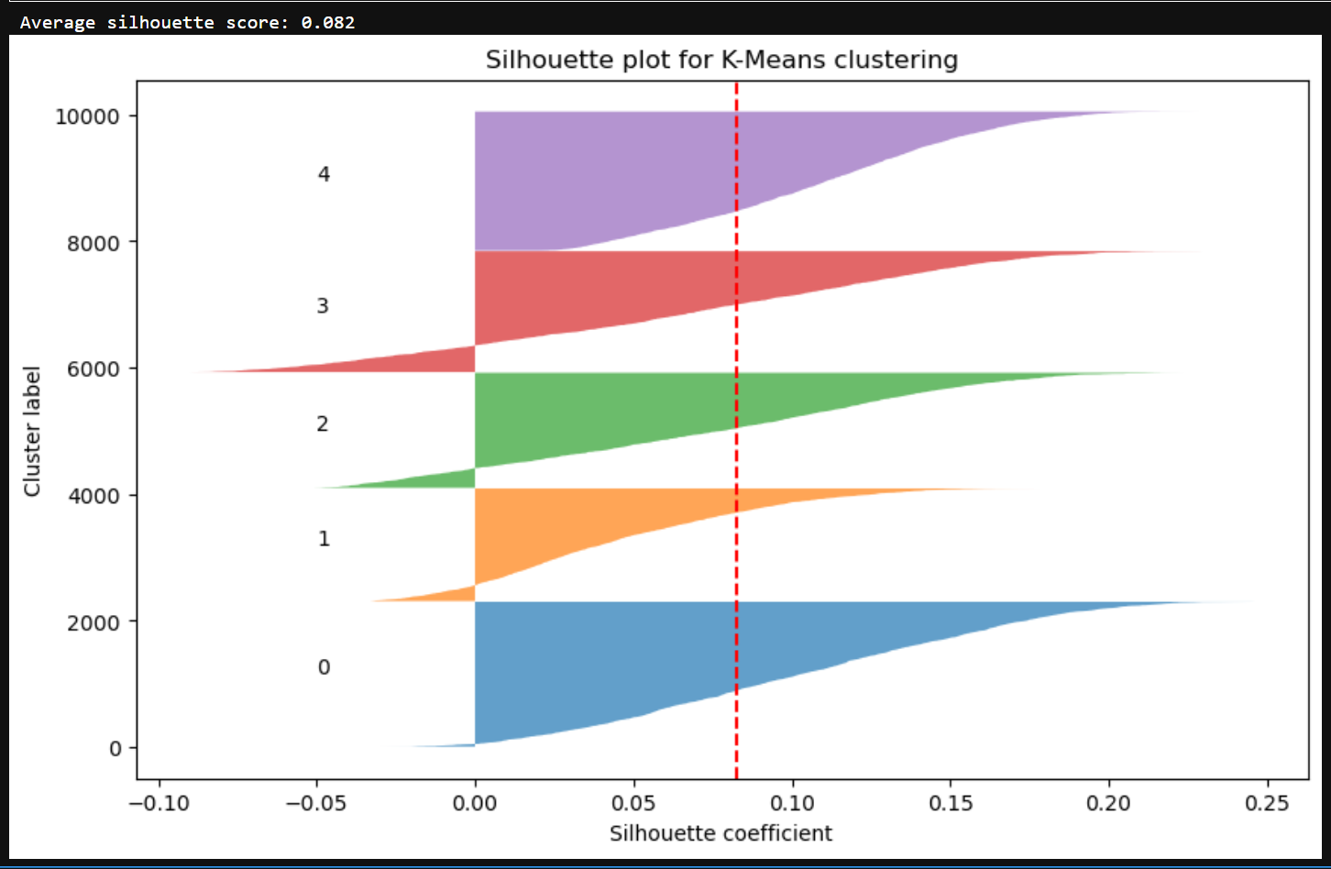
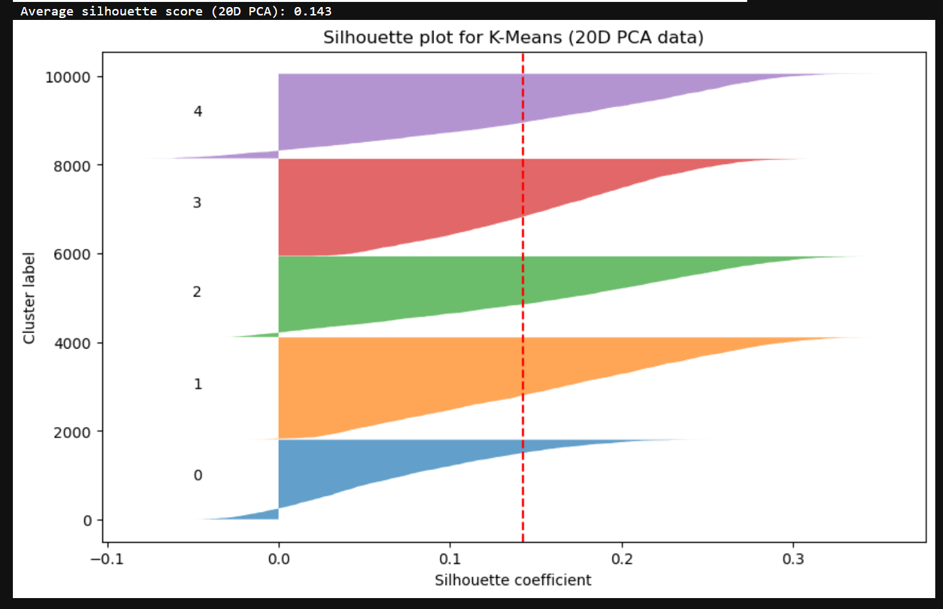
Original Versus PCA

Slide 12
Best Clustering Option
From looking at the ARI and the silhouette plots, the better clustering option is the 20D PCA model because the average silhouette score was higher while the ARI was similar to the original model.

